Slide 1

INDIAN INSTITUTE OF TECHNOLOGY PATNA
BIHTA - 801106, INDIA
Capstone Project Semester-2 — Group 8

Slide 2

Content
Introduction
Phase 1: Symptom-Disease Prediction
Phase 2: Advanced Predictions
Pregnancy Risk Prediction
Heart Disease Prediction
Diabetic Disease Prediction
4. Technologies and Tools
5. Conclusion

Slide 3
AI Health Guard
Your Personalized Health Advisor
Presented by: Alok Kumar Choudhary
Roll No.: 2312RES77
Date: 27 June 2024

Slide 4


Introduction
AI Health Guard: Your Personalized Health Advisor
AI Health Guard aims to revolutionize healthcare accessibility in remote and rural areas through advanced Data Science and Machine Learning techniques.
Provide early diagnosis, personalized health counseling, and preventative advice in regions with a shortage of medical professionals.
Enhance healthcare accessibility with advanced predictive models.

Slide 5
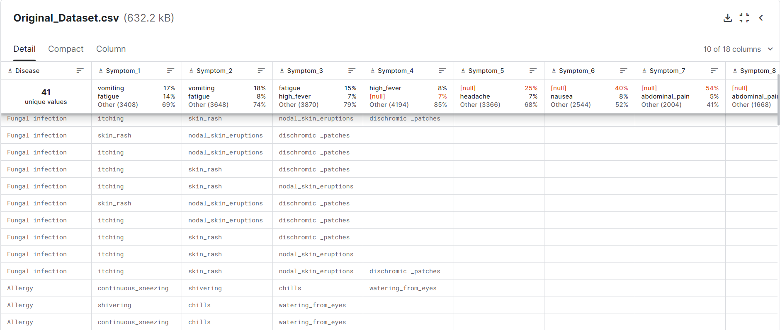
Phase 1: Symptom-Disease Prediction
Data Acquisition: Data sourced from Kaggle, including 8 CSV files with diverse health information.
Notes:
The data for "AI HEALTH GUARD" is taken from Kaggle, a platform for data scientists and machine learning engineers. This dataset includes 8 CSV files :-
● Original Dataset.csv: The main dataset used for Symptoms-Disease prediction model.
● description.csv: Gives detailed descriptions of the health conditions.
● diets.csv: Provides information about which diets are appropriate for various health conditions.
● workout_df.csv: Lists planned ways that are suited to an individual's specific health demands and encompasses work-outs combined with lifestyle advice for a healthy lifestyle.
● medications.csv: Gives details of when and how to take what kind of medication, should you need some.
● precautions_df.csv: Lists the different precautions that you are advised to adopt when facing various health conditions.
● symtoms_df.csv: Contains an exhaustive list of symptoms presented by different illnesses.
● Symptom-severity.csv: Describes the severity of specific symptoms.

Slide 6
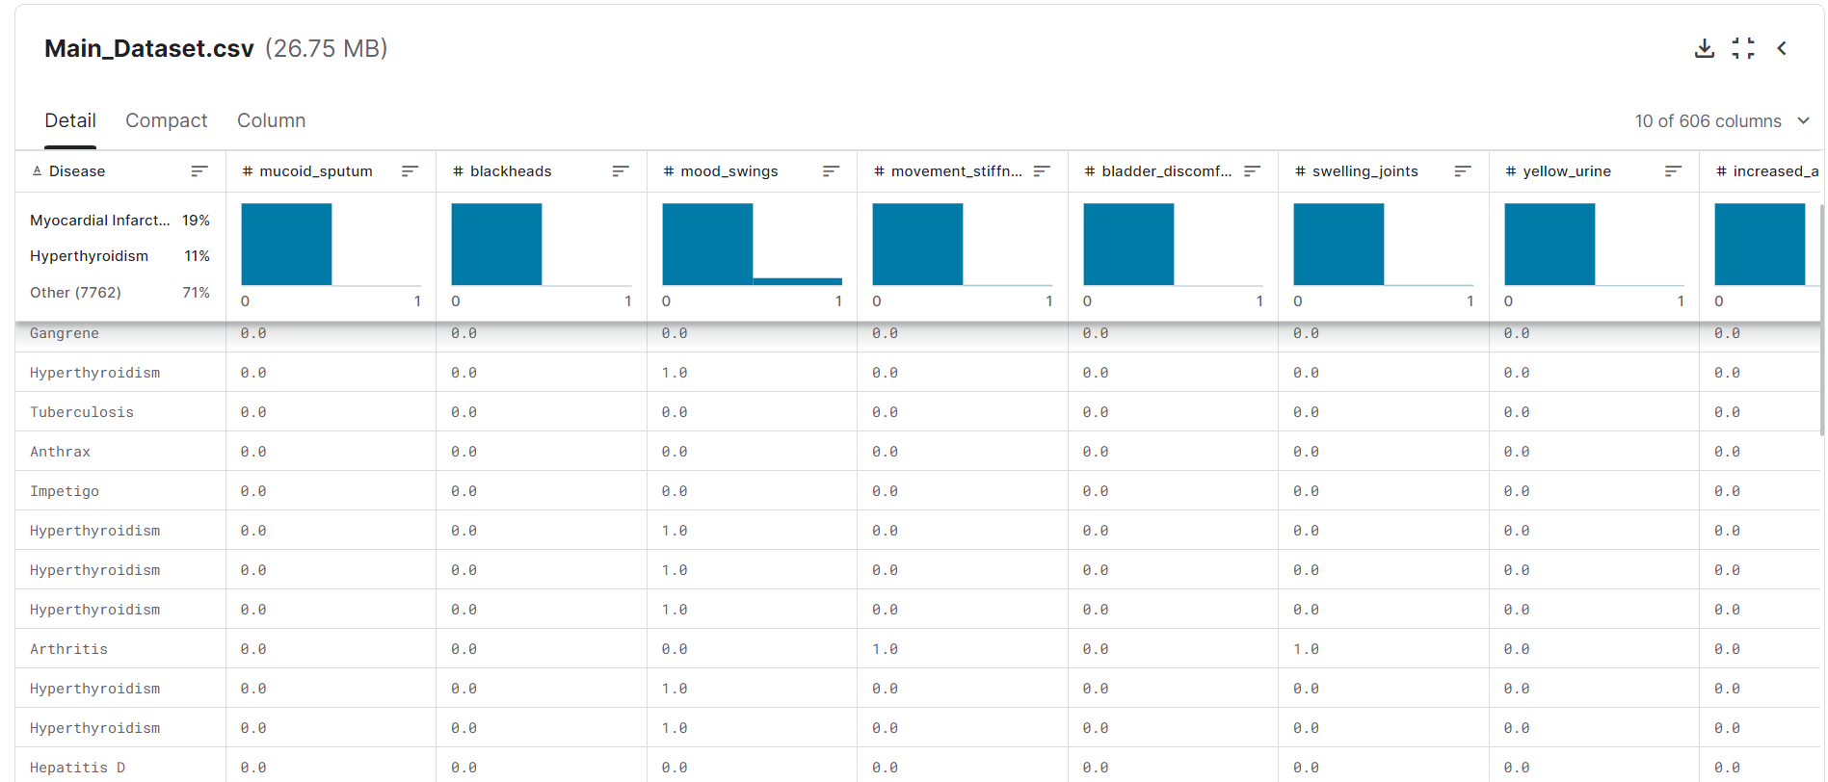
Phase 1: Symptom-Disease Prediction
Data Acquisition: Data sourced from Kaggle, including 8 CSV files with diverse health information.
Notes:
The data for "AI HEALTH GUARD" is taken from Kaggle, a platform for data scientists and machine learning engineers. This dataset includes 8 CSV files :-
● Original Dataset.csv: The main dataset used for Symptoms-Disease prediction model.
● description.csv: Gives detailed descriptions of the health conditions.
● diets.csv: Provides information about which diets are appropriate for various health conditions.
● workout_df.csv: Lists planned ways that are suited to an individual's specific health demands and encompasses work-outs combined with lifestyle advice for a healthy lifestyle.
● medications.csv: Gives details of when and how to take what kind of medication, should you need some.
● precautions_df.csv: Lists the different precautions that you are advised to adopt when facing various health conditions.
● symtoms_df.csv: Contains an exhaustive list of symptoms presented by different illnesses.
● Symptom-severity.csv: Describes the severity of specific symptoms.

Slide 7
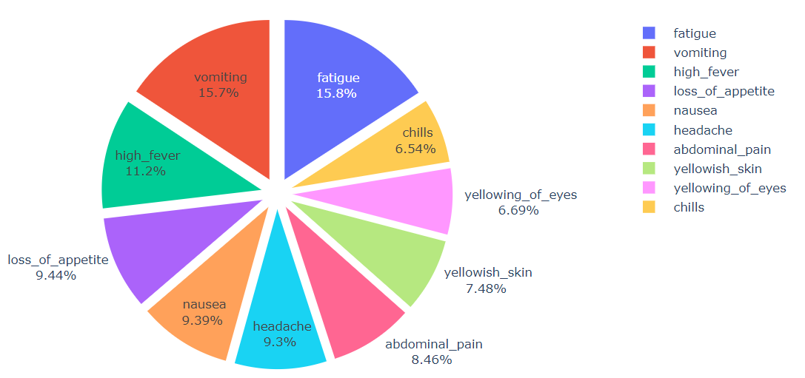
Phase 1: Symptom-Disease Prediction
Data Preprocessing: Steps include data inspection, transformation, and visualization to prepare for modeling.
There are 10961 entries and 606 columns in the dataset.
A significant number of columns contain missing values.
Data Visualization:
NOTE :- The visualization of the data has been done on some samples of the original dataset.
Top Symptoms in datasets is :-

Slide 8
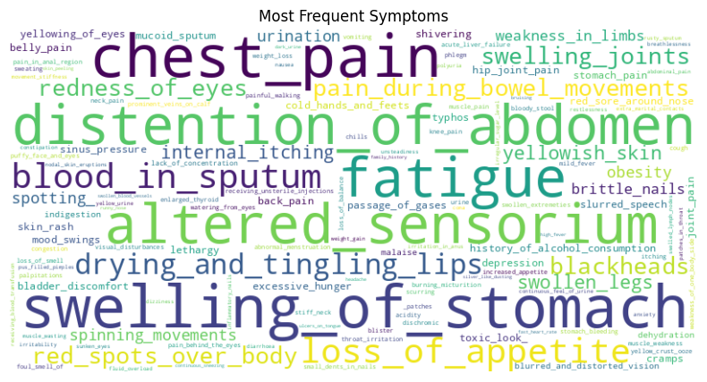
Phase 1: Symptom-Disease Prediction
Data Visualization:
A word cloud was created to visualize the most common symptoms across the dataset :-

Slide 9
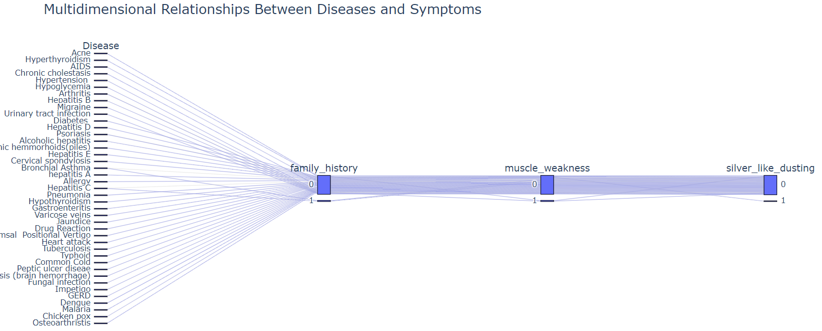
Phase 1: Symptom-Disease Prediction
Data Visualization:
Multidimensional Relationships Between Diseases and Symptoms:-
Notes:
It shows relationships between multiple categorical variables. In this example, the categories are different diseases and symptoms. Each vertical axis represents a single variable, and each data point is a combination of categories across all variables. Lines connect the data points, showing how different categories co-occur.

Slide 10
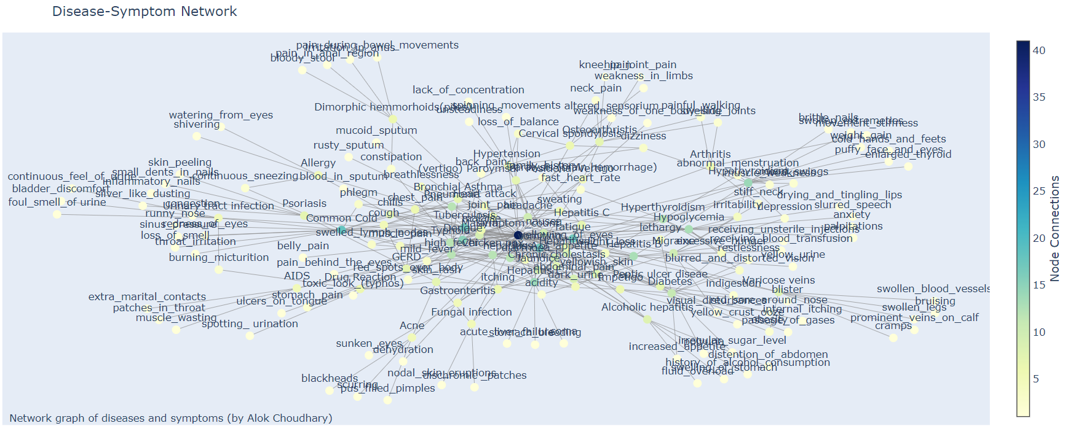
Phase 1: Symptom-Disease Prediction
Data Visualization:
Disease-Symptom Network:-
Notes:
Nodes in the graph represent various diseases and symptoms. Edges connect nodes that frequently co-occur together. Thicker edges indicate stronger connections.

Slide 11
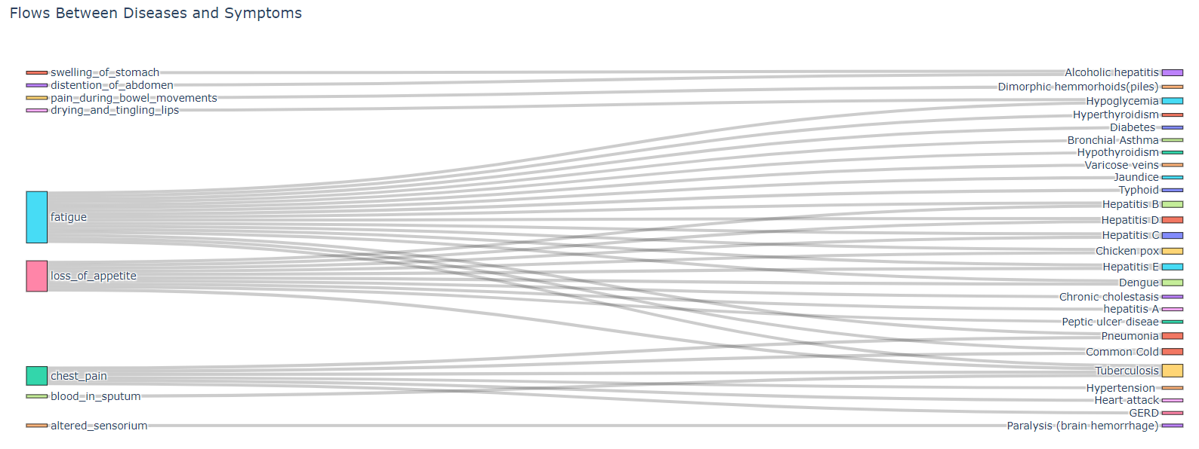
Phase 1: Symptom-Disease Prediction
Data Visualization:
Flows Between Diseases and Symptoms:-
Notes:
The diagram shows the flow of patients between different diseases and related symptoms.
The width of the arrows represents the number of patients experiencing a particular symptom or disease.

Slide 12
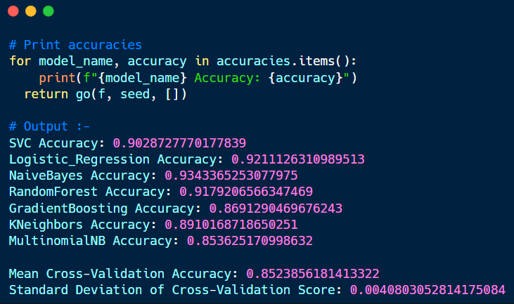
Phase 1: Symptom-Disease Prediction
Model Training:
Seven classification models tested; Naive Bayes model with high accuracy selected:-
The accuracy results show that the Naive Bayes model performed the best with an accuracy of 93.43%, followed by Logistic Regression at 92.11%.
The cross-validation results show consistent performance across the folds, with a mean accuracy of 85.24% and a low standard deviation of 0.41%, indicating stable model performance.
Based on the best results among all models, the final model was chosen to be the Naive Bayes Classifier. In the future, it should be noted that the Naive Bayes model trained can be saved and used for making predictions.

Slide 13
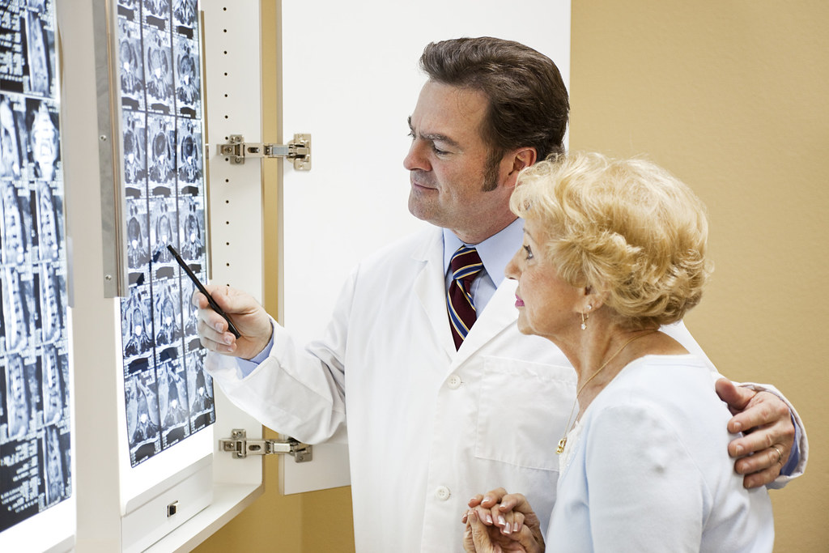
Phase 1: Symptom-Disease Prediction
Prediction System and Results:
Developed a recommendation system providing disease diagnosis and related advice.
The model is used to predict the disease, as recommended by the tutor, after receiving the symptoms from the user. The prediction is followed by providing relevant recommendations including:
● Description of the predicted disease
● Precautions to be taken
● Recommended medications
● Suggested workouts
● Appropriate diets

Slide 14
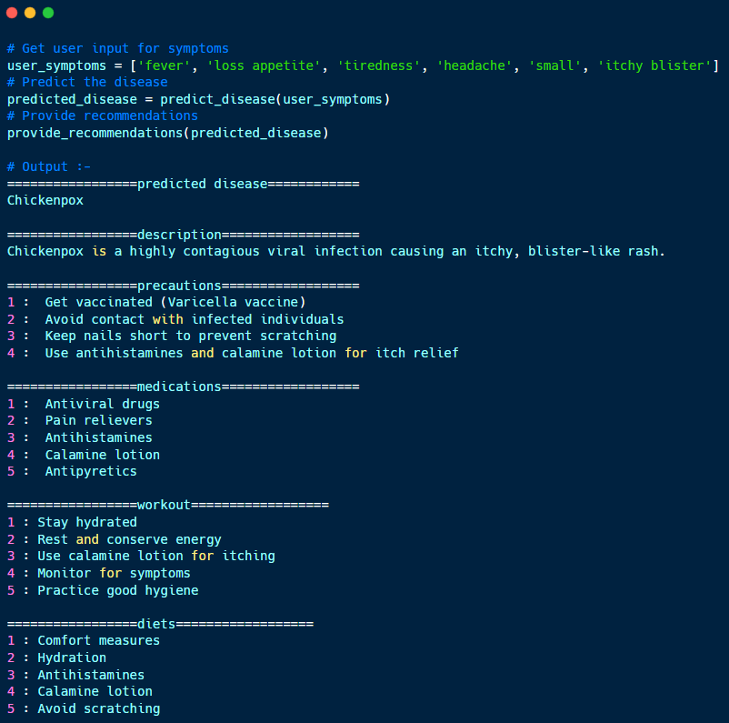
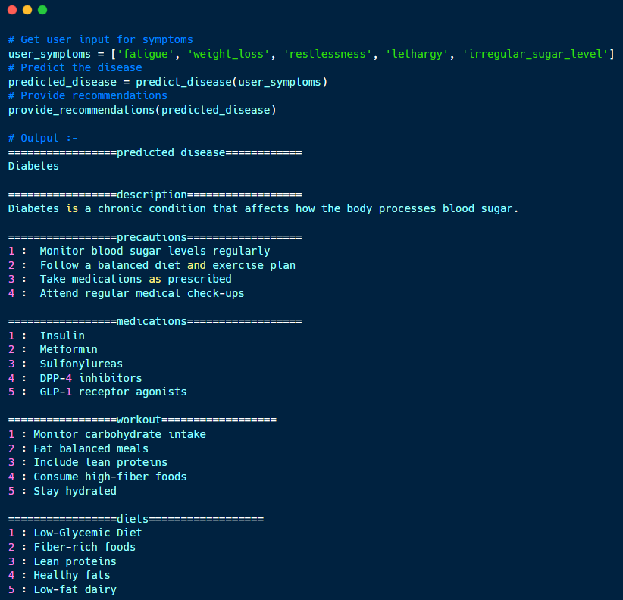
Phase 1: Symptom-Disease Prediction
Example Case :

Slide 15

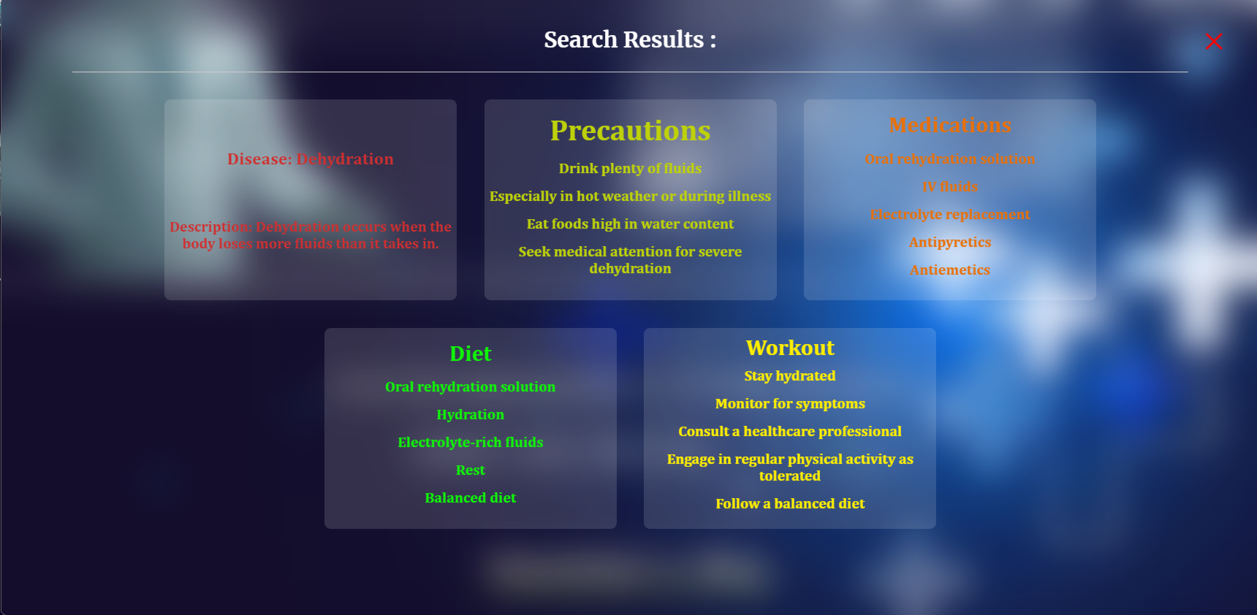
Phase 1: Symptom-Disease Prediction
Final Result :

Slide 16

Phase 2: Pregnancy Risk Prediction
Develop a predictive model to assess pregnancy risk levels (low, mid, high).
Data Overview
The dataset consists of 1,014 entries with 7 attributes :
Key Descriptive Statistics:
Age: Age of the patient
Systolic BP: Systolic blood pressure
Diastolic BP: Diastolic blood pressure
BS: Blood sugar levels
Body Temp: Body temperature
Heart Rate: Heart rate
Risk Level: Risk level (low, mid, high)

Slide 17
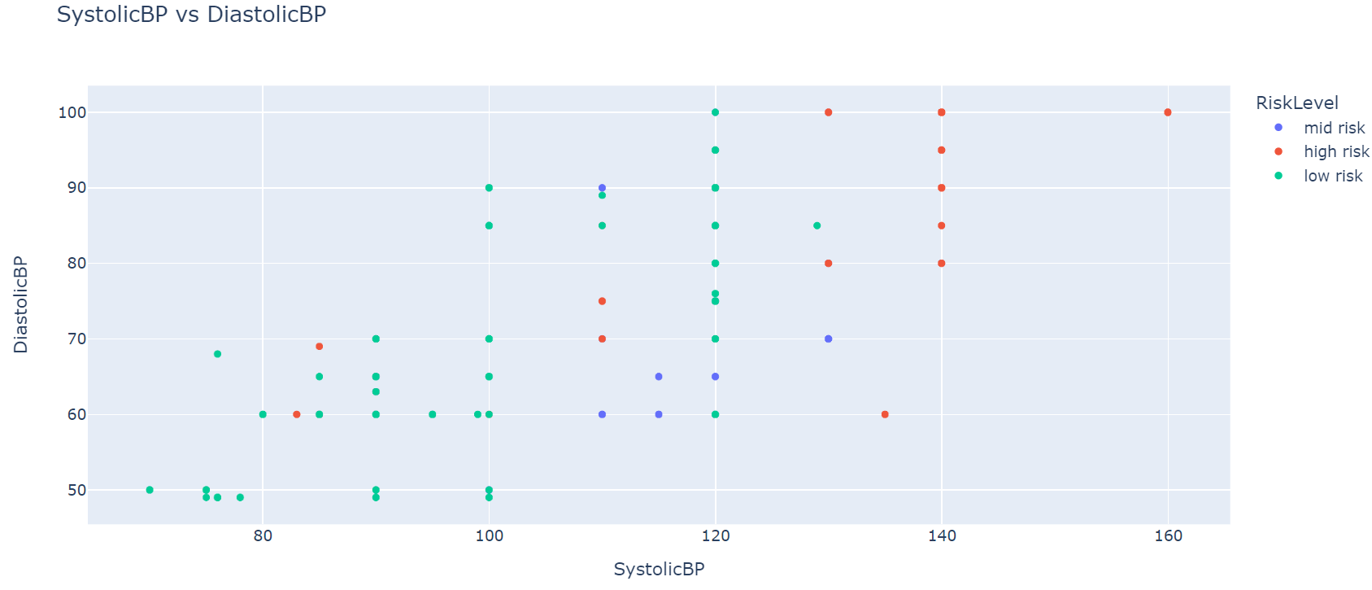
Phase 2: Pregnancy Risk Prediction
Data Visualization:
Blood Pressure vs Risk Level :
High BP linked to higher risk
Low risk ranges below 120/80; high risk above 140/90.

Slide 18

Phase 2: Pregnancy Risk Prediction
Model Training:
Data Splitting :
Features: Age, Diastolic BP, BS, Body Temp, Heart Rate
Target: Risk Level
Train-Test Split: 80% training, 20% testing
Top Performers Model:
Random Forest: Highest accuracy (81.77%)
Gradient Boosting Classifier: Second best with strong performance.
Decision Tree: Good but overfitting risk
The final Random Forest model was saved using pickle for future use. A function was created to predict the risk level based on new data inputs.

Slide 19
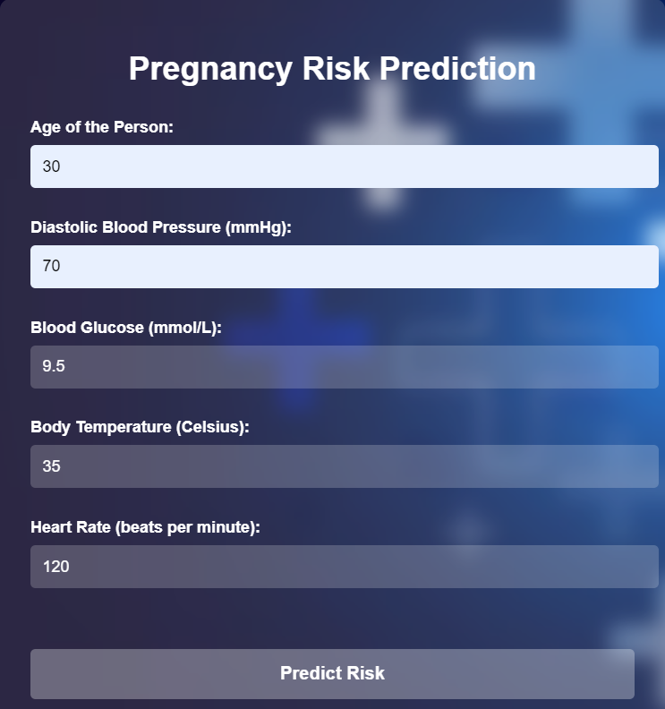
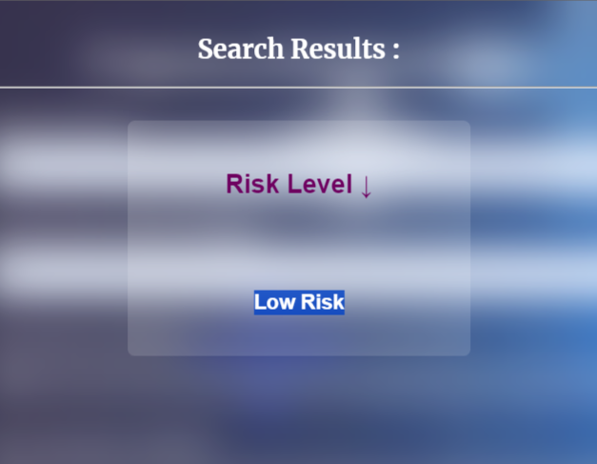
Phase 2: Pregnancy Risk Prediction
Prediction System and Results:
Developed a model using health indicators like BP, blood sugar, body temperature, etc.

Slide 20

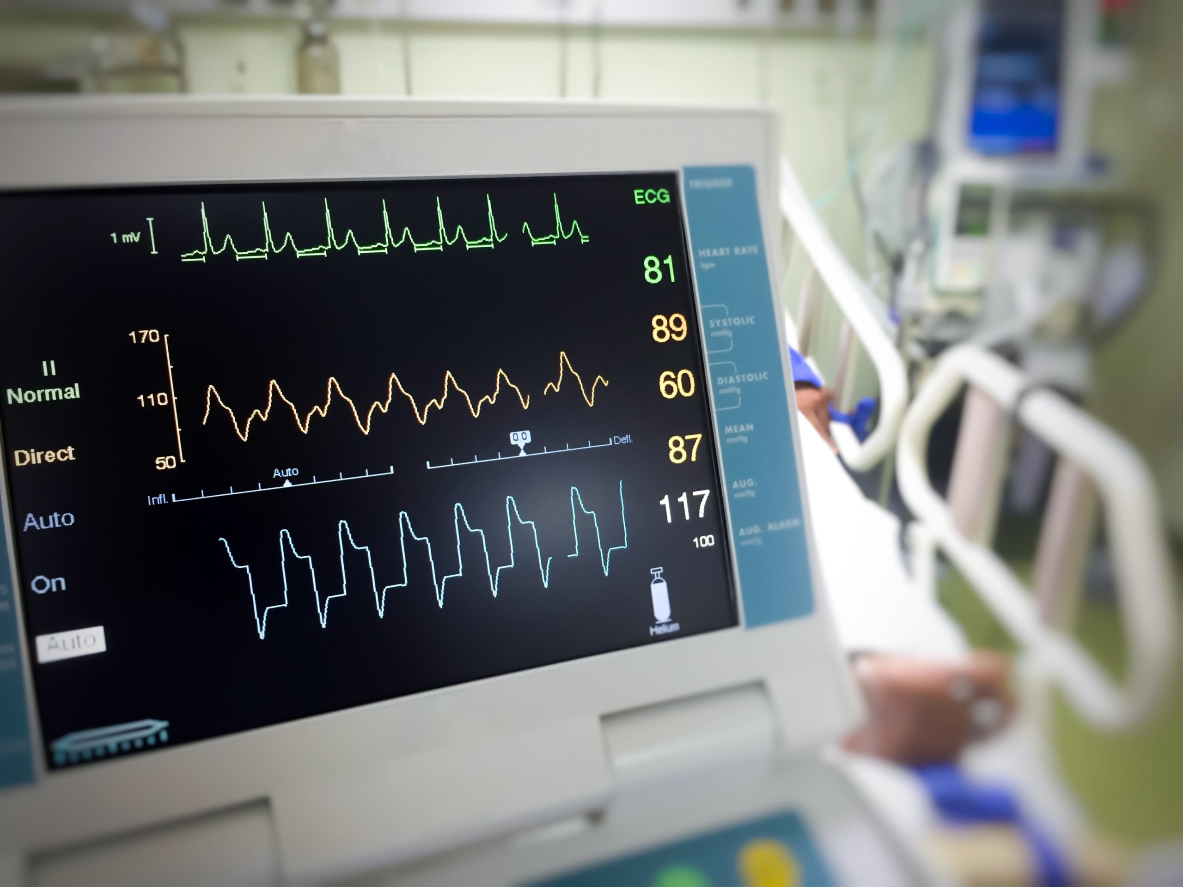
Phase 2: Heart Disease Prediction
Global health problem with significant mortality and hospitalization rates.
Data Overview:
The dataset consists of 303 entries with 13 attributes :
Balance Dataset : 165 positive, 138 negative
Feature Information :
Age, Sex
Chest Pain Type
Resting Blood Pressure
Serum Cholesterol
Fasting Blood Sugar
Resting ECG Results
Maximum Heart Rate
Exercise-Induced Angina
ST Depression,
Slope of ST Segment
Number of Major Vessels
Thalassemia
Notes:
Heart Disease Prediction

Slide 21
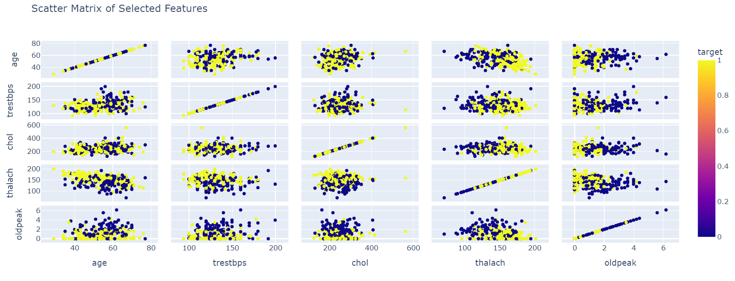
Phase 2: Heart Disease Prediction
Data Visualization:
Selected features to visualize pairwise relationships.
Higher target values (yellow) are scattered across all features but are more concentrated in lower old peak values and higher thalassemia values.
There is no strong linearity among the other features except for age that is uniformly distributed, forming a diagonal line.

Slide 22

Phase 2: Heart Disease Prediction
Model Training:
Data Splitting :
Training Set: 80% (242 entries)
Testing Set: 20% (61 entries)
Top Performers Model:
Logistic Regression: Highest accuracy and robust performance after hyperparameter tuning. (85.25%)
Random Forest: Second best with strong performance.
Decision Tree: Performed well but with potential overfitting issues.
Cross Validation :
Cross-validation was performed on the best model (Logistic Regression) to ensure its robustness.
Accuracy: 85.24%
Average Cross-Validation Score: 82.51%
MSE: 0.14
MAE: 0.14
The final Logistic Regression model was saved using pickle for future use. A function was created to predict the risk level based on new data inputs.

Slide 23
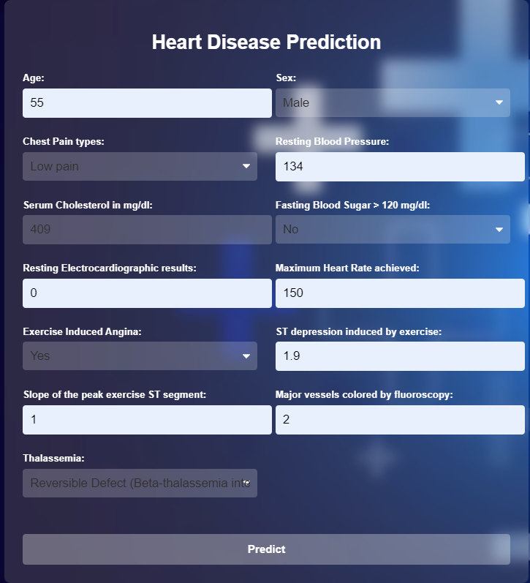
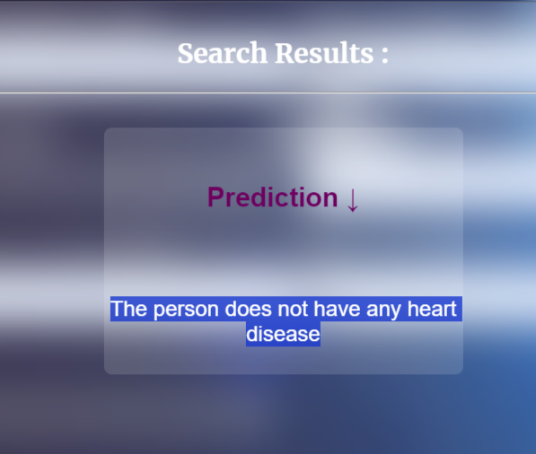
Phase 2: Heart Disease Prediction
Prediction System and Results:
Utilized 13 features including age, sex, cholesterol levels.

Slide 24

Phase 2: Diabetic Disease Prediction
A chronic medical condition affecting millions globally.
Data Overview:
The dataset consists of 768 entries with 9 attributes :
Distribution:
Non-Diabetic: 500 (65.1%)
Diabetic: 268 (34.9%)
Feature Information :
Pregnancies
Glucose
Blood Pressure
Skin Thickness
Insulin
BMI
Diabetes Pedigree Function
Age
Outcome
Notes:
Diabetic Disease Prediction

Slide 25
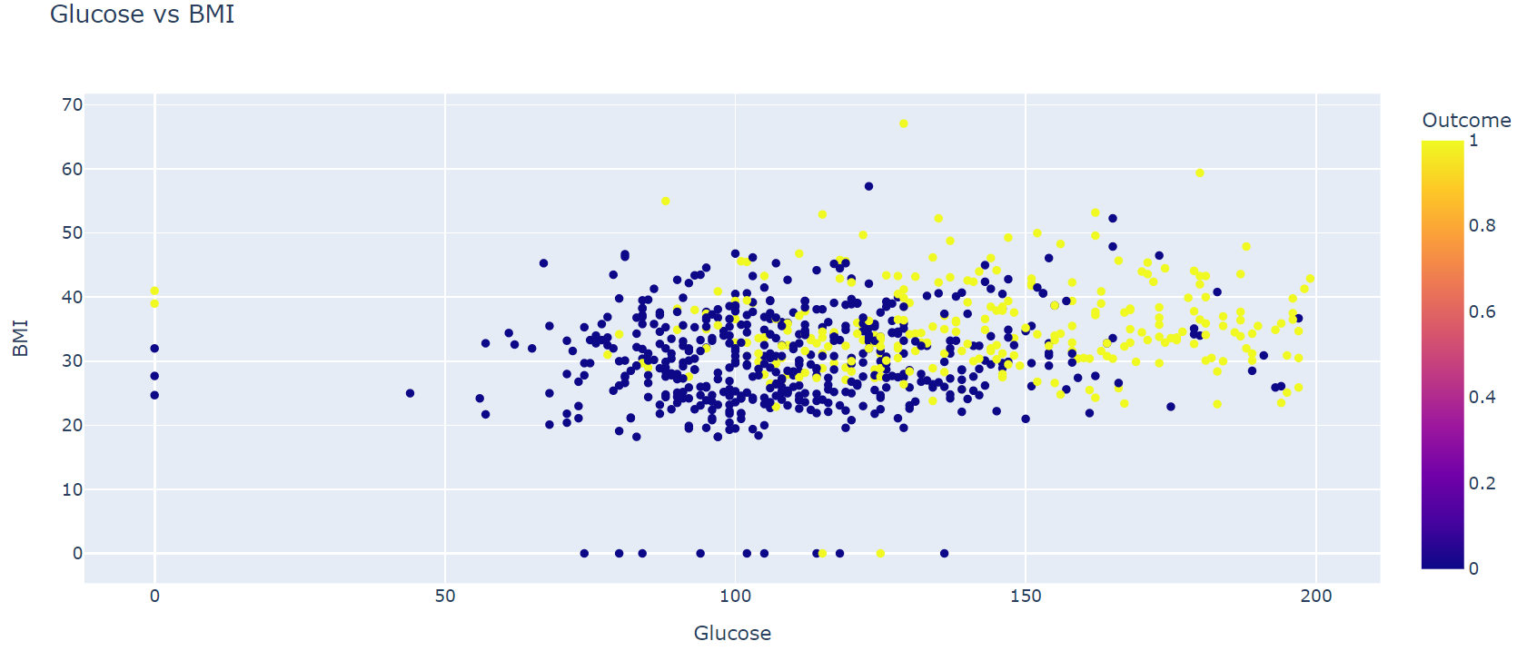
Phase 2: Diabetic Disease Prediction
Data Visualization:
Glucose vs BMI:
Higher glucose levels correlate with higher likelihood of diabetes .
BMI has a wide range of values across all glucose levels, with no strong linear correlation evident between BMI and outcome.

Slide 26
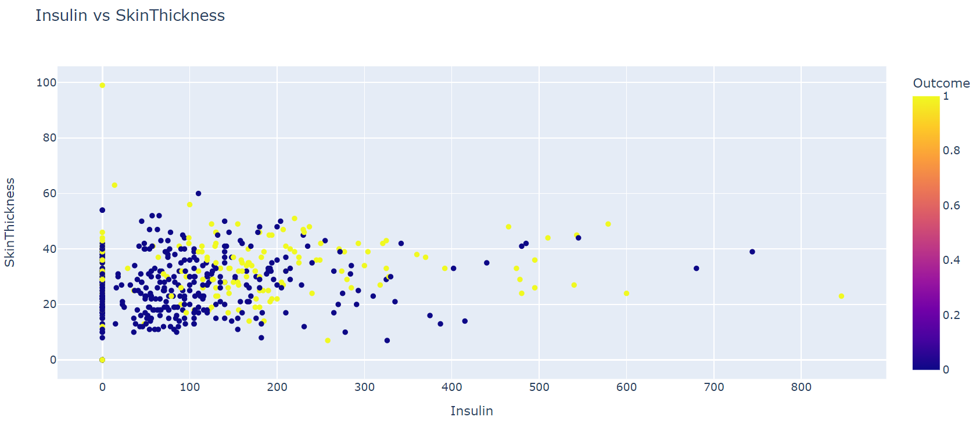
Phase 2: Diabetic Disease Prediction
Data Visualization:
Insulin vs Skin Thickness:
A potential correlation between insulin levels and skin thickness is suggested, where data points with lower insulin levels appear to be more densely packed in the lower left quadrant of the graph.
Lower insulin levels densely packed in lower left quadrant.

Slide 27
Phase 2: Diabetic Disease Prediction
Model Training:
Data Splitting :
Training Set: 80% (614 entries)
Testing Set: 20% (154 entries)
Top Performers Model:
Highest Accuracy: Logistic Regression & Random Forest (75.97%)
Lowest Accuracy: K-Nearest Neighbors (69.5%)
Other Metrics: Precision, Recall, F1 Score with Logistic Regression showing highest overall performance.
Cross Validation :
Cross-validation was performed on the best model (Logistic Regression) to ensure its robustness.
Accuracy: 75.97 %
Average Cross-Validation Score: 75.91%
The final Logistic Regression model was saved using pickle for future use. A function was created to predict the risk level based on new data inputs.

Slide 28
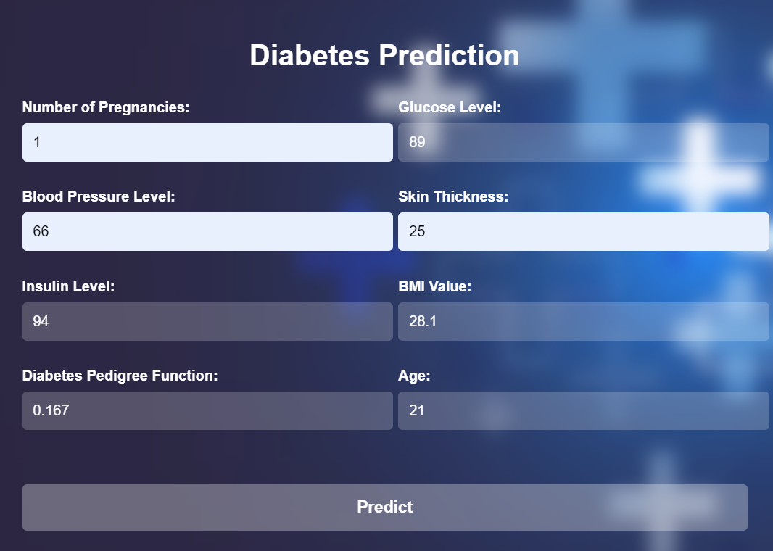
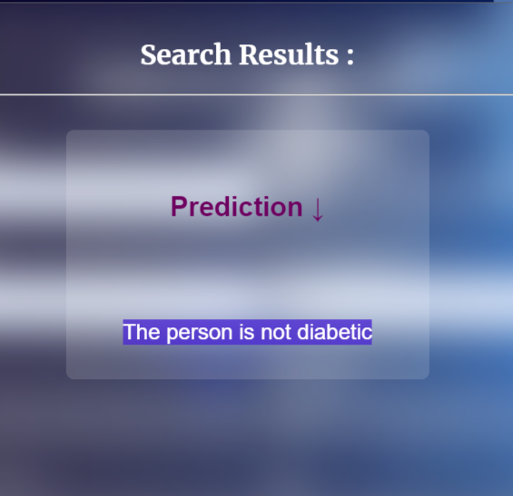
Phase 2: Diabetic Disease Prediction
Prediction System and Results:
Focused on predicting diabetes risk using features like glucose, BMI, and insulin levels.

Slide 29

Technologies and Tools
Data Science Techniques:
Python: Used for data manipulation and model development.
Feature Engineering: Transforming raw data into features.
Exploratory Data Analysis (EDA): Visual methods to understand dataset characteristics.
Machine Learning:
Algorithms: Regression and classification models.
Advanced Techniques: Hyperparameter tuning,
ensemble techniques, and handling outliers.
Software and Frameworks:
Python Libraries: NumPy, Pandas, Scikit-learn.
Visualization: Matplotlib, Plotly.
Web Development: Flask, Streamlit.

Slide 30
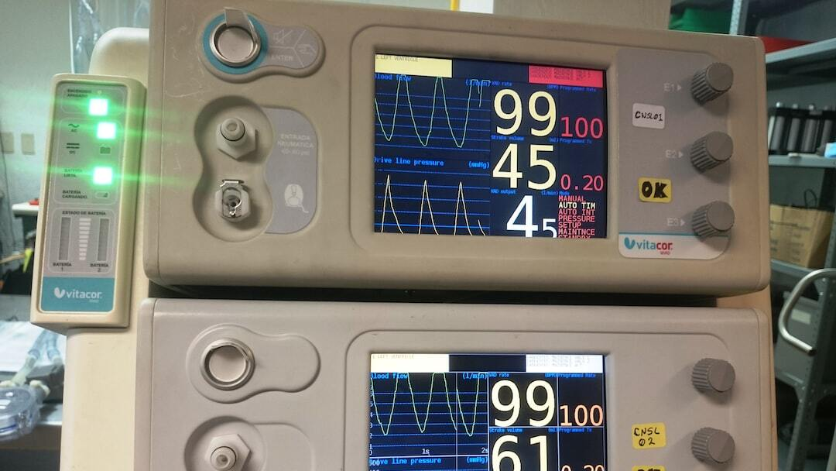
Conclusion
Further Enhancement :
Scalability improvements for larger data sizes.
Feature upgrades for real-time data processing and advanced visualization.
Automation and AI integration for enhanced accuracy and efficiency.
Inclusion of more diseases and health conditions.
Conclusion :
The project has achieved its major deliverables and
provides a solution to real-life problems.
AI Health Guard has the potential to bridge
healthcare gaps and make quality healthcare advice
accessible to everyone.
Vision :
To continue improving and expanding the project to
benefit more users.

